Slide 1
“CROWD PREDICTION FOR BUS LINES USING ARTIFICIAL INTELLIGENCE”
Project Reference No.:47S_BE_0343
BILURU GURUBASAVA MAHASWAMIJI INSTITUTE OF TECHNOLOGY MUDHOL-587313
DEPARTMENT OF COMPUTER SCIENCE AND ENGINEERING
Student(s) Name:
1. MR. GOPAL CHENNI
2. MISS. PRADNYA BILAGI
3. MR. DHANUSH YADAV
4. MR. NIRANJAN PURAD
Guide(s) Name:
1. Prof. Varun P. Sarvade
2. Prof. Vinayak Telasang

Slide 2
OBJECTIVES
Develop an AI model that can accurately predict whether bus should be allocated for the given source and destination.
To improve public transportation efficiency and passenger experience on KSRTC buses using artificial intelligence models like Decision Tree, Artificial Neural Network, Recurrent Neural Network and Long short Term Memory.
Provide a comparative analysis of all the above mentioned models in terms of accuracy and loss.

Slide 3
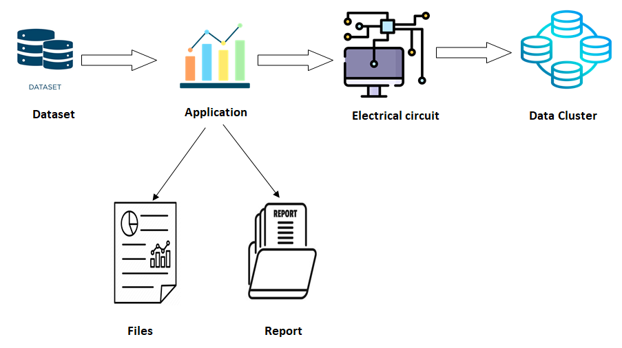
METHODOLOGY
Figure 1: Architecture of Passenger Flow
In this context, predicting the number of passengers on bus lines is essential to optimize the planning, management and organization of the public transport service. In this project, we propose a methodology to predict the number of passengers on bus lines.

Slide 4
Table: Sample Data Set Table
Source | Destination | Trip | Route | Slot No | Adults | Childs | Revenue | Passenger count | Label
1 | 2 | 3 | 1 | 1 | 50 | 4 | 2589 | 54 | 1
1 | 4 | 3 | 1 | 1 | 50 | 10 | 3289 | 60 | 1
1 | 7 | 2 | 2 | 2 | 48 | 4 | 5478 | 52 | 0
1 | 13 | 2 | 3 | 3 | 49 | 7 | 5100 | 56 | 1
1 | 10 | 2 | 3 | 3 | 54 | 4 | 4989 | 58 | 1
After collecting the data to compare, the next step is to load and pre-process the data, to ensure that it is in the correct format and that it was clean and error-free. The following steps will be used for pre-processing:

Slide 5
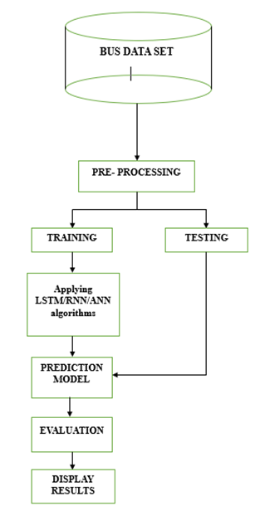
Input: Bus routine Database
Output: Bus crowd prediction
Step 01: Pre-Processing of data sheet
Step 02: Training and Testing the Data set
A. If Training is successful go to next step
Else go to first step
B. If Testing is successful go to direct Prediction model
Else go to first step
Step 03: Apply LSTM/ RNN/ ANN algorithm
Step 04: Evaluation
Step 05: Display results.
Figure 2: Flow chart

Slide 6
WORK PLAN
For this project we have considered four cities namely Mudhol, Jamakhandi, Vijayapura, and Bagalkote as sources for KSRTC bus lines and only destination from these sources are considered.
The dataset was prepared using the offline data obtained from KSRTC offices of above mentioned cities.
The most common of which are data gathering, preprocessing, model training, evaluation, and deployment. This is a broad synopsis of the procedure like identifying problem statement, data collection to monetizing the results.

Slide 7
SUMMARY OF PROGRESS (DESIGN, EXPERIMENTS, RESULTS) (Maximum 2 Slides)
the successful implementation of AI for crowd prediction in bus lines holds immense potential for optimizing public transportation systems. By leveraging data-driven insights, transit authorities can proactively manage crowd levels, enhance passenger experiences, and ultimately improve the overall efficiency of urban mobility. As we continue to refine and expand upon this project, we aim to contribute to the advancement of smart transportation solutions for sustainable and accessible cities.
Decision Tree, ANN model, LSTM model and RNN model gives 99%, 53%, 93% and 97% of accuracy value respectively.

Slide 8
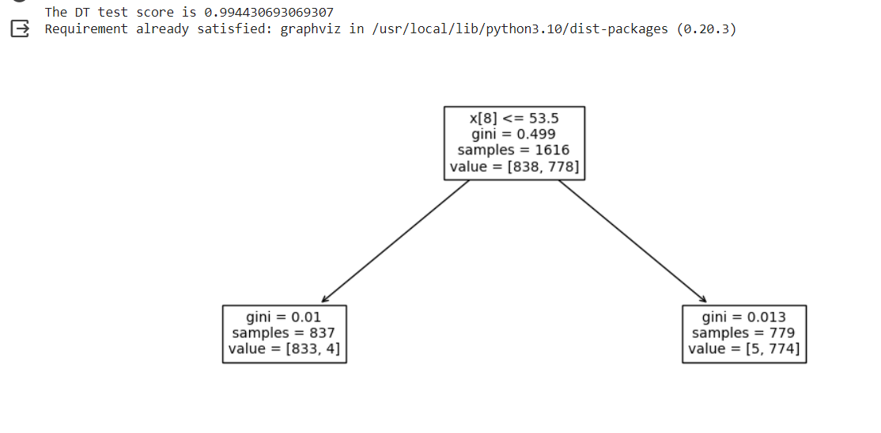
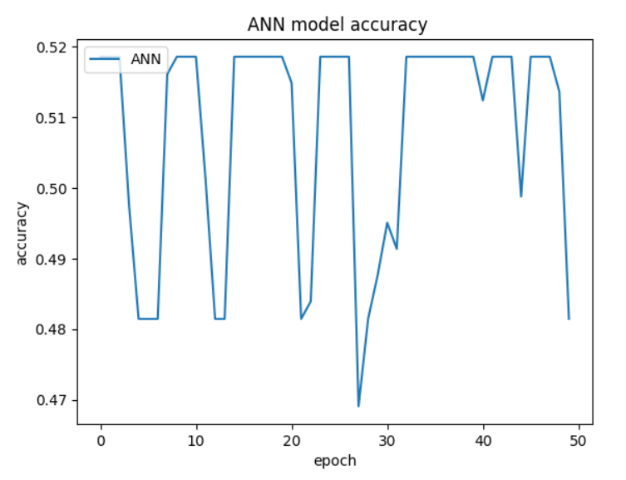
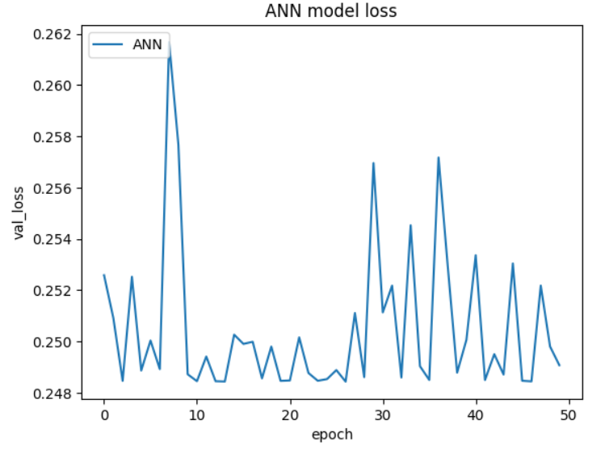
RESULTS USING DECISION TREE
RESULTS USING ARTIFICIAL NEURAL NETWORK MODEL
Figure 4:Epoch v/s Model Accuracy
Figure 3: Decision tree accuracy score
Figure 5:Epoch v/s Model Loss

Slide 9
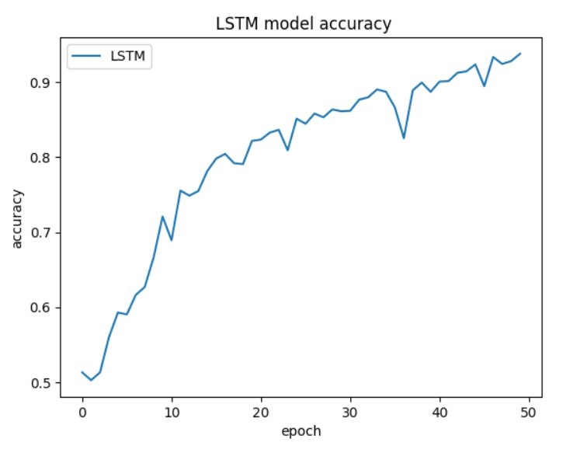
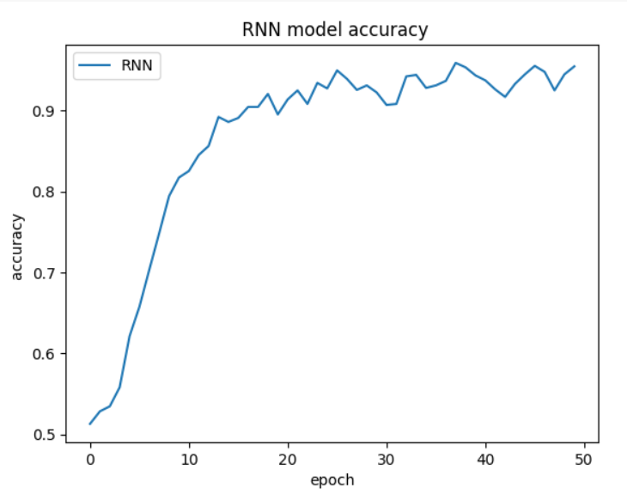
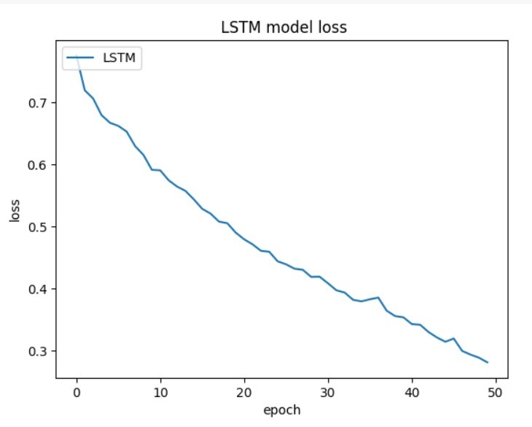
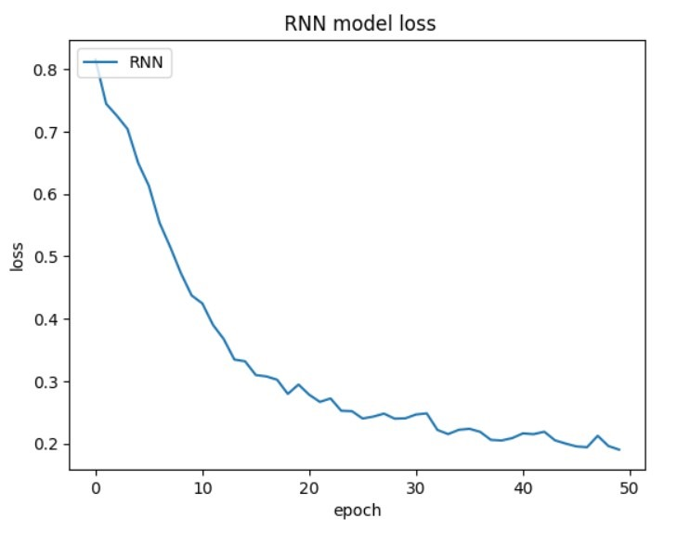
RESULTS USING LONG SHORT TERM MEMORY MODEL
Result USING RECURRENT NEURAL NETWORK MODEL
Figure 6:Epoch v/s Model Accuracy
Figure 8: Epoch v/s Model Accuracy
Figure 7:Epoch v/s Model Loss
Figure 9:Epoch v/s Model Loss

Slide 10
Table: Comparison Between 4 Models with accuracy and loss Results
Sl. No. | Decision Tree | ANN | LSTM | RNN
Accuracy | 99% | 53% | 93% | 97%
Loss | 0.24 | 0.10 | 0.20 | 0.15

Slide 11
SCIENCE & TECHNOLOGY COMPONENT / INNOVATIVENESS / NOVELTY OF THE PROJECT
SCOPE FOR FURTHER DEVELOPMENT / PROTOTYPE DEVELOPMENT / INDUSTRIAL COLLABORATION / IPR SUPPORT (Maximum 2-3 Slides)
The crowd prediction project for the bus line, utilizing AI, has yielded insightful conclusions. Through the implementation of sophisticated algorithms and machine learning techniques, we have successfully forecasted crowd densities along the bus route with notable accuracy. Our model's ability to analyse various factors such as source, destination, trip, route, slot no, and other parameters has proven instrumental in generating reliable predictions.
ANN, LSTM and RNN models to get better accuracy and here RNN will gives 97% accuracy with compare to other models.

Slide 12
In conclusion, the successful implementation of AI for crowd prediction in bus lines holds immense potential for optimizing public transportation systems. By leveraging data-driven insights, transit authorities can proactively manage crowd levels, enhance passenger experiences, and ultimately improve the overall efficiency of urban mobility. As we continue to refine and expand upon this project, we aim to contribute to the advancement of smart transportation solutions for sustainable and accessible cities.

Slide 13
THANK YOU
ANY QUESTIONS?

